Slide 1
UNIT - VI Graphics Programming & File Handling (6 hrs)
Graphics class
Introduction to AWT packages. Handling events on AWT components
Introduction to Swing package, components and containers.
Concept of streams
Stream Classes, Byte stream, Character stream
Creation of files, reading or writing characters / bytes
Concatenating and buffering files
Random access files.

Slide 2
Graphics class
Main feature in java is creating a graphical interface.
Graphics in any language gives a wonderful look and feel to the users.
Two packages that are mainly used to draw graphics.
Applet package
awt package

Slide 3
Graphics Programming Graphics Class
The Graphics class is the abstract base class.
A Graphics object manages a graphics context and draws pixels on the screen that represent text and other graphical object (e.g., lines, ellipses, rectangles and other polygons).
Graphics objects contain methods for drawing, font manipulation, color manipulation and the like.

Slide 4
Drawing methods of graphics class
drawString(String str, int x, int y)
Draws the text given by the specified string, using this graphics context's current font and color.
abstract void drawLine(int x1, int y1, int x2, int y2)
Draws a line, using the current color, between the points (x1, y1) and (x2, y2) in this graphics context's coordinate system.
abstract void drawOval(int x, int y, int width, int height)
Draws the outline of an oval.

Slide 5
Drawing methods of graphics class
drawArc(int x, int y, int width, int height, int startAngle, int arcAngle)
Draws the outline of a circular or elliptical arc covering the specified rectangle.
drawRect(int x, int y, int width, int height)
Draws the outline of the specified rectangle.
fillArc(int x, int y, int width, int height, int startAngle, int arcAngle)
Fills a circular or elliptical arc covering the specified rectangle.

Slide 6
Drawing methods of graphics class
fillPolygon(int[] xPoints, int[] yPoints, int nPoints)
Fills a closed polygon defined by arrays of x and y coordinates.
fillRect(int x, int y, int width, int height)
Fills the specified rectangle.

Slide 7
Drawing methods of graphics class
setColor(Color c)
Sets this graphics context's current color to the specified color.
setFont(Font font)
Sets this graphics context's font to the specified font.
getColor()
Gets this graphics context's current color.

Slide 8
Example of Graphics class

Slide 9
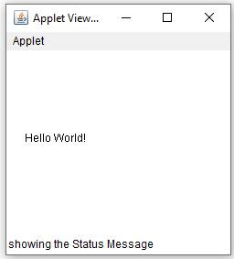
//package practical;
/*<applet code="DrawStringApplet" width="700" height="500"></applet>*/
import java.applet.Applet; //import java.applet.*;
import java.awt.Graphics; // import java.awt.*;
public class DrawStringApplet extends Applet
{
public void paint(Graphics g)
{
g.drawString("Hello World!", 20, 100);
showStatus("showing the Status Message");
}
}
The method paint() gives us access to an object of type Graphics class. Using the object of the Graphics class, we can call the drawString() method of the Graphics class to write a text message in the applet window.

Slide 10
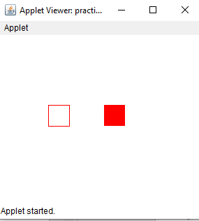
//package practical;
import java.applet.Applet;
import java.awt.Color;
import java.awt.Graphics;
public class GraphicsDemo extends Applet
{
public void paint(Graphics g)
{
g.setColor(Color.red);
g.drawRect(70,100,30,30);
g.fillRect(170,100,30,30);
}
}

Slide 11
Abstract Window Toolkit (AWT)
The Abstract Window Toolkit (AWT) was Java’s first GUI framework, and it has been part of Java since version 1.0.
It contains numerous classes and methods that allow you to create windows and simple controls.
Java AWT (Abstract Windowing Toolkit) is an API to develop GUI or window-based application in java.

Slide 12
Abstract Window Toolkit (AWT)
Java AWT components are platform-dependent i.e. components are displayed according to the view of operating system.
AWT is heavyweight i.e. its components uses the resources of system.
The java.awt package provides classes for AWT API such as TextField, Label, TextArea, RadioButton, CheckBox, Choice, List etc.
https://docs.oracle.com/javase/7/docs/api/java/awt/package-summary.html

Slide 13
AWT classes
The AWT classes are contained in the java.awt package.
It is one of Java’s largest packages.

Slide 14
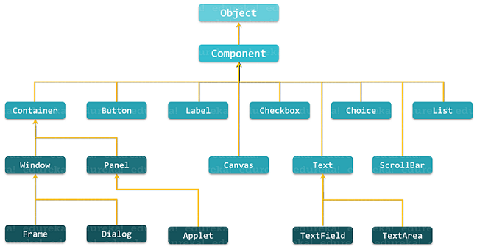
Hierarchy Of AWT

Slide 15
Component & Container
In Java, a component is the basic user interface object and is found in all Java applications.
Components include lists, buttons, panels, and windows.
To use components, you need to place them in a container.
A container is a component that holds and manages other components.
Containers display components using a layout manager.

Slide 16
Component
At the top of the AWT hierarchy is the Component class .
Component is an abstract class that encapsulates all of the attributes of a visual component.
Except for menus, all user interface elements that are displayed on the screen and that interact with the user are subclasses of Component.

Slide 17
Component
It defines over a hundred public methods that are responsible for managing events, such as mouse and keyboard input, positioning and sizing the window, and repainting.
A Component object is responsible for remembering the current foreground and background colors and the currently selected text font.

Slide 18
Container
Before adding the components that make up a user interface, the programmer must create a container.
The Container is a component in AWT that can contain another components like buttons, textfields, labels etc.
The classes that extends Container class are known as container such as Frame, Dialog and Panel.
A container is responsible for laying out (that is, positioning) any components that it contains

Slide 19
Container
class Window - The window is the container that have no borders and menu bars. You must use frame, dialog or another window for creating a window.
Frame - The Frame is the container that contain title bar and can have menu bars. It can have other components like button, text field etc.
Panel - The Panel is the container that doesn't contain title bar and menu bars. It can have other components like button, text field and etc.
Canvas - It represents a rectangular area where application can draw something or can receive inputs created by user.

Slide 20
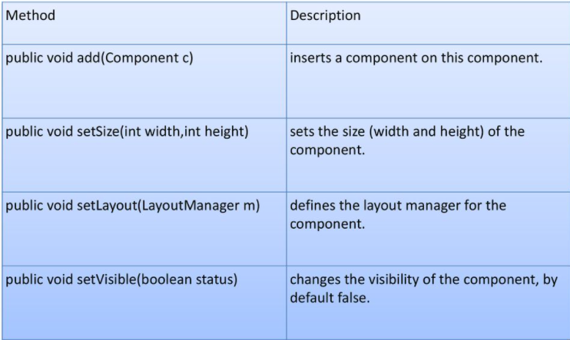
Useful Methods of Component class

Slide 21
Java AWT Example
To create simple awt example, you need a frame. There are two ways to create a frame in AWT.
By extending Frame class (inheritance)
By creating the object of Frame class (association)

Slide 22
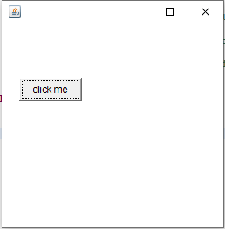
//package practical;
import java.awt.Button;
import java.awt.Frame;
class GraphicsDemo extends Frame{
GraphicsDemo(){
Button b=new Button( “click me” );
b.setBounds(30,100,80,30); // setting button position
add(b); //adding button into frame
setSize(300,300); //frame size 300 width and 300 height
setLayout(null); //no layout manager
setVisible(true); //now frame will be visible, by default not visible
}
public static void main(String args[])
{
GraphicsDemo f=new GraphicsDemo();
}
}

Slide 23
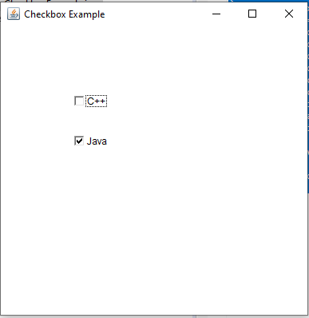
//package practical;
import java.awt.*;
public class CheckboxExample
{
CheckboxExample(){
Frame f= new Frame("Checkbox Example");
Checkbox checkbox1 = new Checkbox("C++");
checkbox1.setBounds(100,100, 50,50);
Checkbox checkbox2 = new Checkbox("Java", true);
checkbox2.setBounds(100,150, 50,50);
f.add(checkbox1);
f.add(checkbox2);
f.setSize(400,400);
f.setLayout(null);
f.setVisible(true);
}
public static void main(String args[])
{
new CheckboxExample(); } }

Slide 24
Java AWT Example using PANEL

Slide 25
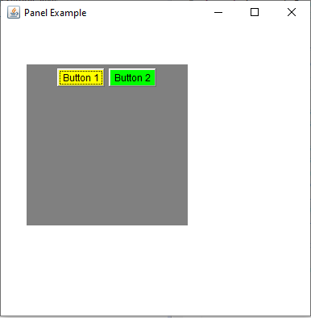
package practical;
import java.awt.Button;
import java.awt.Color;
import java.awt.Frame;
import java.awt.Panel;
public class PanelExample {
PanelExample()
{
Frame f= new Frame("Panel Example");
Panel panel=new Panel();
panel.setBounds(40,80,200,200);
panel.setBackground(Color.gray);
Button b1=new Button("Button 1");
b1.setBounds(50,100,80,30 );
b1.setBackground(Color.yellow);
Button b2=new Button("Button 2");
b2.setBounds(100,100,80,30);
b2.setBackground(Color.green);
panel.add(b1);
panel.add(b2);
f.add(panel);
f.setSize(400,400);
f.setLayout(null);
f.setVisible(true);
}
public static void main(String args[])
{
new PanelExample();
}
}

Slide 26
Java GUI Event Handling
Any program that uses GUI such as Java application written for windows, is event driven.
Event describes the change in state of any object.
For Example : Pressing a button, Entering a character in Textbox, Clicking or Dragging a mouse, etc.
https://docs.oracle.com/javase/7/docs/api/java/awt/event/package-summary.html

Slide 27
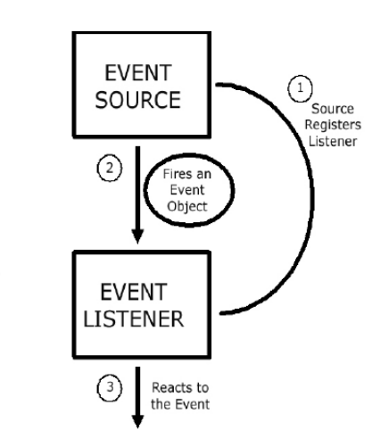
Components of Event Handling
Event handling has three main components,
Events : An event is a change in state
of an object.
Events Source : Event source is an
object that generates an event.
Listeners : A listener is an object that
listens to the event.
A listener gets notified when an event occurs.

Slide 28
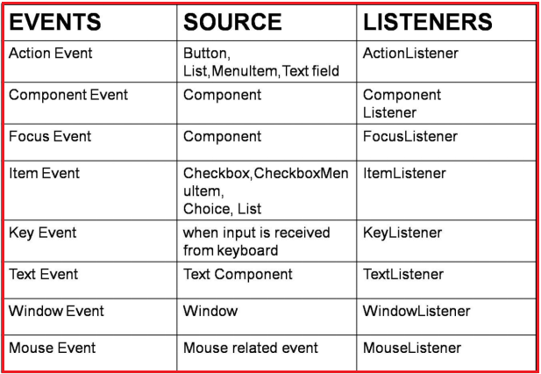
Event Sources and Their Listeners

Slide 29
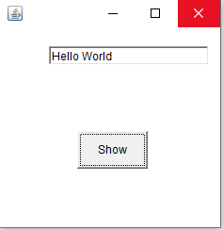
package practical;
import java.awt.*;
import java.awt.event.*;
class EventHandling extends Frame implements ActionListener
{
TextField textField;
EventHandling ()
{
textField = new TextField ();
textField.setBounds (60, 50, 170, 20);
Button button = new Button ("Show");
button.setBounds (90, 140, 75, 40);
button.addActionListener (this);
add (button);
add (textField);
setSize (250, 250);
setLayout (null);
setVisible (true);
}
public void actionPerformed (ActionEvent e)
{
textField.setText ("Hello World");
}
public static void main (String args[])
{
new EventHandling ();
}
}

Slide 30
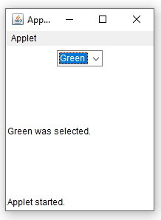
package practical;
import java.applet.Applet;
import java.awt.BorderLayout;
import java.awt.Choice;
import java.awt.Label;
import java.awt.Panel;
import java.awt.event.ItemEvent;
import java.awt.event.ItemListener;
public class SimpleAWT extends Applet implements ItemListener {
private Choice choice = new Choice();
private Label label = new Label("Pick something!");
public void init() {
choice.addItemListener(this);
setLayout(new BorderLayout());
choice.addItem("Red");
choice.addItem("Green");
choice.addItem("Blue");
Panel panel = new Panel();
panel.add(choice);
add(label, "Center");
add(panel, "North");
}
public void itemStateChanged(ItemEvent e) {
if (e.getSource() == choice) {
label.setText(choice.getSelectedItem() + " was selected.");
}
}
}

Slide 31
SWINGS
Java provides many GUI frameworks that help us in developing a variety of GUI applications.
We have seen Abstract Window Toolkit or AWT.
AWT is one of the oldest GUI frameworks in Java and is also platform dependent.
Another disadvantage of AWT is its heavyweight components.

Slide 32
SWINGS
The Swing framework in Java is a part of Java Foundation Classes or commonly called JFCs.(The Java Foundation Classes (JFC) are a graphical framework for building portable Java-based graphical user interfaces (GUIs). )
The Swing framework in Java is built on top of the AWT framework and can be used to create GUI applications just like AWT.
But unlike AWT, the Swing components are light-weight and are platform-independent.

Slide 33
SWINGS
The Swing framework in Java is provided through the ‘javax.swing’ package. (javax- prefix used for a package of Java standard extensions)
The classes in the javax.swing package begins with the letter ‘J’.
In a javax.swing package, we will have classes like JButton, JFrame, JTextField, JTextArea, etc.
Swing has various advanced component.
Swing API in Java adapts MVC (Model View Controller) Architecture.

Slide 34
A Swing API hierarchy in Java

Slide 35
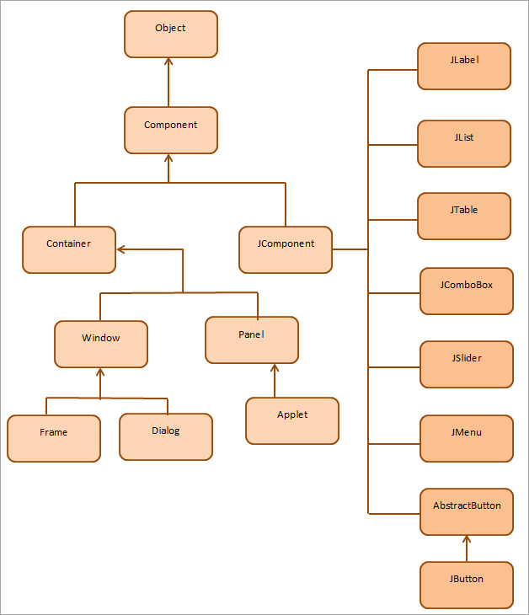

Slide 36
Java Swing Components
Swing has a big set of components that we can include in our programs and avail the rich functionalities using which we can develop highly rich GUI
A component can be defined as a control that can be represented visually and is usually independent.
It has got a specific functionality and is represented as an individual class in Swing API
For example, class JButton in swing API is a button component and provides the functionality of a button.
One or more components form a group and this group can be placed in a “Container”.
A container provides a space in which we can display components and also manage their spacing, layout, etc.

Slide 37
Containers
JWindow
JWindow is a top-level window that doesn't have any trimmings and can be displayed anywhere on a desktop.
JWindow is a heavyweight component.
You usually use JWindow to create pop-up windows and "splash" screens.
JWindow extends AWT's Window class.
JFrame
JFrame is a top-level window that can contain borders and menu bars.
JFrame is a subclass of JWindow and is thus a heavyweight component. We place a JFrame on a JWindow.
JFrame extends AWT's Frame class.

Slide 38
Containers
JDialog
JDialog is a lightweight component that you use to create dialog windows.
We can place dialog windows on a JFrame or JApplet.
JDialog extends AWT's Dialog class.
JApplet
JApplet is a container that provides the basis for applets that run within web browsers.
JApplet is a lightweight component that can contain other graphical user interface (GUI) components.
JApplet extends AWT's Applet class.

Slide 39
JFrame In Java
A Frame, in general, is a container that can contain other components such as buttons, labels, text fields, etc.
A Frame window can contain a title, a border, and also menus, text fields, buttons, and other components.
An application should contain a frame so that we can add components inside it.
The Frame in Java Swing is defined in class javax.swing.JFrame.
JFrame class inherits the java.awt.Frame class.
JFrame is like the main window of the GUI application using swing.

Slide 40
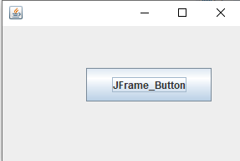
package practical;
import javax.swing.*;
class FrameInherited extends JFrame{
JFrame f;
FrameInherited(){
JButton b=new JButton("JFrame_Button”);
b.setBounds(100,50,150, 40);
add(b);//add button on frame
setSize(300,200);
setLayout(null);
setVisible(true);
}
public static void main(String[] args) {
new FrameInherited();
}
}

Slide 41
Stream Classes in Java
Streams in Java represent an ordered sequence of data.
Java performs input and output operations in the terms of streams
Modern versions of Java platform define two types of I/O streams:
Byte streams
Character streams
https://docs.oracle.com/javase/7/docs/api/java/io/package-summary.html

Slide 42
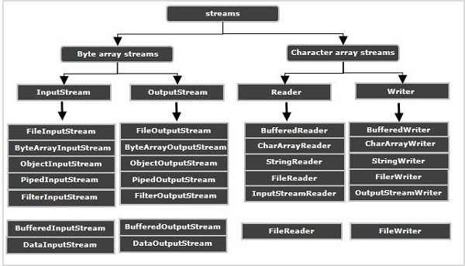
Input and Output Streams (classes) in Java

Slide 43
Byte Streams
Byte streams in Java are designed to provide a convenient way for handling the input and output of bytes (i.e., units of 8-bits data).
They are used for reading or writing to binary data I/O.
They are especially used when we are working with binary files such as executable files, image files, and files in low-level file formats such as .zip, .class, .obj, and .exe.
Binary files are those files that are machine-readable.
For example, a Java class file is an extension of “.class” and cannot be read by humans.

Slide 44
Byte Streams
Another realtime example is storing a photo in a .bmp or .jpeg file.
These files are not human-readable.
They can only be processed by photo editing or image manipulation software.
Byte streams that are used for reading are called input streams and for writing are called output streams.
They are represented by the abstract classes of InputStream and OutputStream in Java.

Slide 45
InputStream Classes in Java
InputStream class is an abstract class.
It is the root class for reading binary I/O data.
It is the superclass of all classes representing an input stream of bytes.
Since InputStream class is an abstract class, we cannot create an object of this class.
We must use subclasses of this class to create an object.

Slide 46
InputStream Subclass | Description
BufferedInputStream | It adds buffering abilities to an input stream. In simple words, it buffered input stream.
ByteArrayInputStream | Input stream that reads data from a byte array.
DataInputStream | It reads bytes from the input stream and converts them into appropriate primitive-type values or strings.
FileInputStream | This input stream reads bytes from a file.
FilterInputStream | It filters bytes from an input stream.
ObjectInputStream | Input stream for objects
PipedInputStream | It creates a communication channel on which data can be received.
PushbackInputStream | It is a subclass of FilterInputStream that adds “pushback” functionality to an input stream.
SequenceInputStream | It is used to read input streams sequentially, one after the other.

Slide 47
OutputStream Classes in Java
OutputStream class is an abstract class.
It is the root class for writing binary data.
It is a superclass of all classes that represents an output stream of bytes.

Slide 48
OutputStream Subclass | Description
BufferedOutputStream | It adds buffering abilities to an output stream. In simple words, it buffered output stream.
ByteArrayOutputStream | Output stream that writes data to a byte array.
DataOutputStream | It converts primitive-type values or strings into bytes and outputs bytes to the stream.
FileOutputStream | It writes byte stream into a file.
FilterOutputStream | It filters bytes from an output stream.
ObjectOutputStream | Output stream for objects
PipedOutputStream | It creates a communication channel on which data can be sent.

Slide 49
Character Streams
Character streams in Java are designed for handling the input and output of characters.
They use 16-bit Unicode characters.
They are mainly used for reading or writing to character or text-based I/O such as text files, text documents, XML, and HTML files.
Character streams that are used for reading are called readers and for writing are called writers.
They are represented by the abstract classes of Reader and Writer in Java.

Slide 50
Reader Stream Classes
Reader stream classes are used for reading characters from files.
Reader is an abstract superclass for all other subclasses such as BufferedReader, StringReader, CharArrayReader, etc.
It implements the Closeable, AutoCloseable, and Readable interfaces.

Slide 51
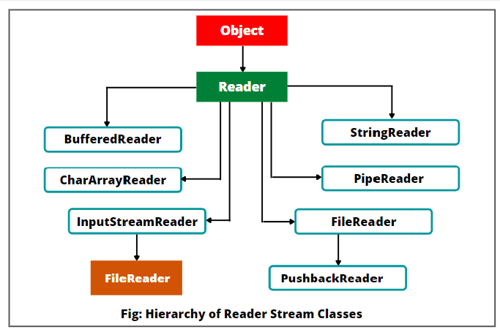

Slide 52
Writer Stream Classes
Writer stream classes are used to write characters to a file.
They are used to perform all output operations on files.
Writer class is an abstract class that acts as a superclass for all the other writer stream classes.
Since the Writer class is an abstract class, it cannot be instantiated.
Therefore, the subclasses of the Writer class are used to write the characters onto the output stream
It implements the Appendable, Closeable, and Flushable interfaces.

Slide 53
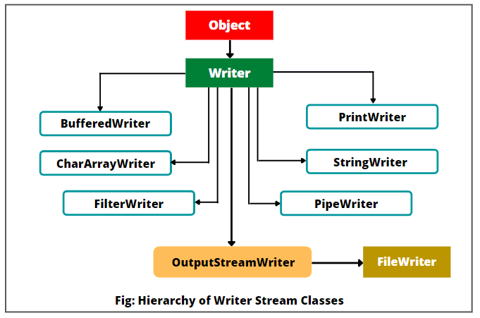

Slide 54
Java Files
File handling is an important part of any application.
Java has several methods for creating, reading, updating, and deleting files.
The File class from the java.io package, allows us to work with files.

Slide 55
Java Files
To use the File class, create an object of the class, and specify the filename or directory name:
Example
import java.io.File; // Import the File class
File myObj = new File("filename.txt"); // Specify the filename
https://docs.oracle.com/javase/7/docs/api/java/io/File.html

Slide 56
The File class has many useful methods for creating and getting information about files. For example:
Method | Type | Description
canRead() | Boolean | Tests whether the file is readable or not
canWrite() | Boolean | Tests whether the file is writable or not
createNewFile() | Boolean | Creates an empty file
delete() | Boolean | Deletes a file
exists() | Boolean | Tests whether the file exists
getName() | String | Returns the name of the file
getAbsolutePath() | String | Returns the absolute pathname of the file
length() | Long | Returns the size of the file in bytes
list() | String[] | Returns an array of the files in the directory
mkdir() | Boolean | Creates a directory

Slide 57
Create a File
To create a file in Java, you can use the createNewFile() method.
This method returns a boolean value:
true if the file was successfully created,
false if the file already exists.
Method is enclosed in a try...catch block.
This is necessary because it throws an IOException if an error occurs (if the file cannot be created for some reason)

Slide 58
package practical;
import java.io.File;
import java.io.IOException;
public class CreateFile {
public static void main(String[] args) {
try {
File myObj = new File("filename.txt");
if (myObj.createNewFile()) {
System.out.println("File created: " + myObj.getName());
} else {
System.out.println("File already exists.");
}
} catch (IOException e) {
System.out.println("An error occurred.");
e.printStackTrace();
}
}
}

Slide 59
Create a File
To create a file in a specific directory (requires permission), specify the path of the file and use double backslashes to escape the "\" character (for Windows).
Example
File myObj = new File("C:\\Users\\MyName\\filename.txt");

Slide 60
Write To a File
Java FileWriter class is used to write character-oriented data to a file.
Use the FileWriter class together with its write() method to write some text to the file we created.
When you are done writing to the file, you should close it with the close() method

Slide 61
import java.io.FileWriter;
import java.io.IOException;
public class WriteToFile {
public static void main(String[] args) {
try {
FileWriter myWriter = new FileWriter("filename.txt");
myWriter.write("Files in Java might be tricky, but it is fun enough!");
myWriter.close();
System.out.println("Successfully wrote to the file.");
} catch (IOException e) {
System.out.println("An error occurred.");
e.printStackTrace();
}
}
}

Slide 62
READ A FILE
FileReader is used for reading streams of characters.

Slide 63
package practical;
import java.io.FileReader;
public class FileReaderExample {
public static void main(String args[])throws Exception
{
FileReader fr=new FileReader ("C:\\Users\\Lenovo\\Desktop\\javaprac\\3FileReader\\A.txt");
int i;
while((i=fr.read())!=-1)
{
System.out.print((char)i);
}
fr.close();
}
}

Slide 64
Read a File
package practical;
import java.io.File;
import java.io.FileNotFoundException;
import java.util.Scanner;
public class ReadFile {
public static void main(String[] args) {
try {
File myObj = new File("filename.txt");
Scanner myReader = new Scanner(myObj);
while (myReader.hasNextLine()) {
String data = myReader.nextLine();
System.out.println(data);
}
myReader.close();
} catch (FileNotFoundException e)
{
System.out.println("An error occurred.");
e.printStackTrace();
}
}
}

Slide 65
package practical;
import java.io.File; // Import the File class
public class GetFileInfo {
public static void main(String[] args) {
File myObj = new File("filename.txt");
if (myObj.exists()) {
System.out.println("File name: " + myObj.getName());
System.out.println("Absolute path: " + myObj.getAbsolutePath());
System.out.println("Writeable: " + myObj.canWrite());
System.out.println("Readable " + myObj.canRead());
System.out.println("File size in bytes " + myObj.length());
} else {
System.out.println("The file does not exist.");
}
}
}

Slide 66
File
Classes available in the Java API that can be used to read and write files in Java:
FileReader, BufferedReader, Files, Scanner, FileInputStream, FileWriter, BufferedWriter, FileOutputStream, etc.
Which one to use depends on the Java version you're working with and whether you need to read bytes or characters, and the size of the file/lines etc.

Slide 67
FileInputStream in Java
FileInputStream in Java is the most basic file input stream class that is designed to read bytes from a file.
It is present in java.io.FileInputStream package.
FileInputStream class is derived from InputStream that is abstract superclass of FileInputStream.

Slide 68
FileInputStream in Java
It implements Closeable and AutoCloseable interfaces.
FileInputStream used to read byte-oriented data (raw bytes streams) like image data, audio, and video.
FileInputStream can also read data from a character stream.
However, the FileReader class is recommended for reading streams of characters.

Slide 69
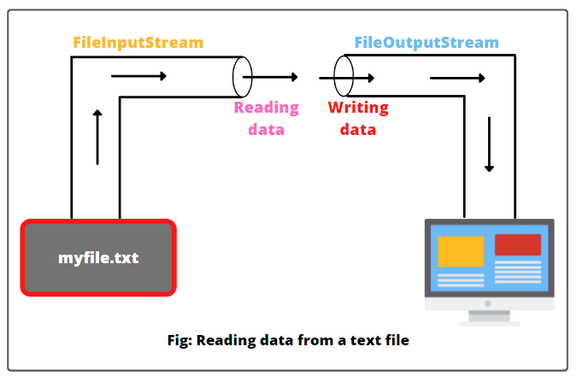

Slide 70
package practical;
import java.io.FileInputStream;
public class ReadFile {
public static void main(String[] args)
{
try {
FileInputStream fis = new FileInputStream("myfile.txt");
int value = 0;
while((value = fis.read())!=-1)
{
System.out.print((char)value);
}
fis.close();
} catch(Exception e){
System.out.println(e);
}
}
}

Slide 71
FileOutputStream
FileOutputStream is an outputstream for writing data/streams of raw bytes to file or storing data to file.
FileOutputStream is a subclass of OutputStream.
FileOutputStream was added in Java 1.0 version. It is present in the java.io.FileOutputStream package.

Slide 72
FileOutputStream
To write primitive values into a file, we use FileOutputStream class.
FileOutputStream is meant for writing streams of raw bytes such as image data.
For writing streams of characters, consider using FileWriter.

Slide 73
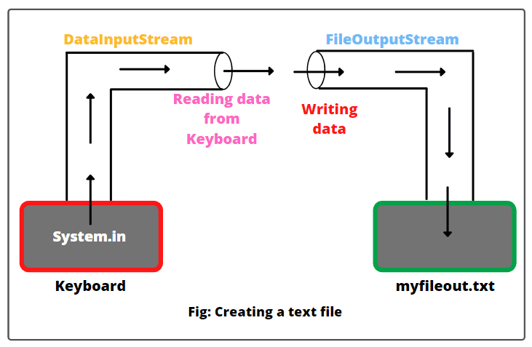

Slide 74
package practical;
import java.io.DataInputStream;
import java.io.FileOutputStream;
public class FileOutputStreamExample {
public static void main(String[] args)
{
try {
// Create an object of DataInputStream to attach keyboard to DataInputStream.
DataInputStream dis = new DataInputStream(System.in);
// Create an object of FileOutputStream to attach myfileout file to FileOutputStream.
FileOutputStream fos = new FileOutputStream("myfileout.txt");
System.out.println("Enter the text (@ at the end)");

Slide 75
int value = 0;
// Read the values (in byte form) from dis into ch and write them into fos.
while((value = dis.read()) != '@'){
char ch = (char)value; // Converting byte values into characters.
fos.write(ch);
}
fos.close(); // Closing file.
System.out.println("Successfully written...");
}
catch(Exception e){
System.out.println(e);
}
}
}

Slide 76
Concatenating and Buffering files
Concatenate: It is possible to concatenate two or more files and save in a different file.
The SequenceInputStream class allows you to concatenate multiple InputStreams.
It reads data of streams one by one. It starts out with an ordered collection of input streams and reads from the first one until end of file is reached, whereupon it reads from the second one, and so on, until end of file is reached on the last of the contained input streams.

Slide 77
Concatenating and Buffering files
Buffer Files: In java, we can create a buffer to store temporary data that is read from & written to a stream and this process known as i/o buffer operation.
Buffer is sit between programmer and source/destination file.
Buffer can be created by using following classes:
BufferedInputClass
BufferedOutputClass

Slide 78
BufferedInputStream
A BufferedInputStream in Java is a concrete subclass of FilterInputStream that wraps (buffers) an input stream into a buffered stream and makes read operations on the stream more efficient and fast.
It is used to speed up the input by reducing the number of disk or file reads by adding an additional layer of functionality around the underlying stream.

Slide 79
BufferedInputStream
For example, FileInputStream and FileOutputStream in Java are unbuffered, meaning that each read and write request is handled directly by the operating system.
It makes the program less efficient because for every read or write request, they will access a disk or file.
It will waste a lot of time.
On the other hand, if we buffer input data from a file by wrapping a FileInputStream (for instance) into a BufferedInputStream, the buffered stream will store data into a temporary block of buffered memory.
And then data is sent individually to the program from the buffer.
Thus, buffered input stream in Java makes file operations more efficient and fast.

Slide 80
Working of BufferedInputStream in Java
In BufferedInputStream, a buffer is internally between the program and the source.
During the read operation, the whole block of data (in bytes) is read from the disk and temporarily stored into the internal buffer in the memory once.
The data are then transferred (read) individually to the program from the buffer.

Slide 81
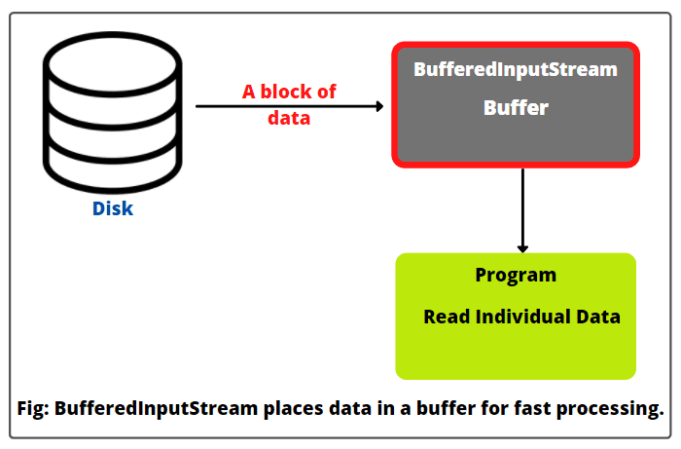

Slide 82
Write a program to concatenate two file A & B and concatenated data print on output screen.

Slide 83
package practical;
import java.io.*;
public class FileConcat {
public static void main(String arg[]) throws IOException {
FileInputStream I1 = null;
FileInputStream I2 = null;
I1 = new FileInputStream("A.txt"); //open file A for concatenate
I2 = new FileInputStream("B.txt"); //open file B for concatenate
SequenceInputStream sis = null; // declare sis to store combined file
sis = new SequenceInputStream(I1, I2);
// create buffer for input output
BufferedInputStream ibs = new BufferedInputStream(sis);
BufferedOutputStream obs = new BufferedOutputStream(System.out);
int c;
while ((c = ibs.read()) != -1) // read& write till the end of buffer
{
obs.write((char) c);
}
ibs.close();
obs.close();
I1.close();
I2.close();
}
}

Slide 84
RandomAccessFile
This class is used for reading and writing to random access file.
A random access file behaves like a large array of bytes.
There is a cursor implied to the array called file pointer, by moving the cursor we do the read write operations.
If end-of-file is reached before the desired number of byte has been read than EOFException is thrown.
It is a type of IOException.

Slide 85
Benefits of Using Random Access File
Unlike IO streams that allow reading and writing data sequentially, random access file allows you to read and write a small chunk of data at any position in the file, using a file pointer.
By controlling this file pointer, you can move forth and back within the file to perform reading and writing operations, at any position you want, in a random fashion.
Random access file is ideal for manipulating a particular file format at low level, such as reading, creating and updating MP3 files, PDF files, etc and even your own file format.a.

Slide 86
Access Modes
The Java RandomAccessFile supports the following access modes:
Mode | Description
r | Read mode. Calling write methods will result in an IOException.
rw | Read and write mode.
rwd | Read and write mode - synchronously. All updates to file content is written to the disk synchronously.
rws | Read and write mode - synchronously. All updates to file content or meta data is written to the disk synchronously.

Slide 87
RandomAccessFile
Before you can work with the RandomAccessFile class you must instantiate it:
RandomAccessFile file = new RandomAccessFile("c:\\data\\file.txt", "rw");
The second input parameter to the constructor: "rw". This is the moSde you want to open file in. "rw" means read / write mode.

Slide 88
Methods of RandomAccessFile
close(): It closes this random access file stream and releases any system resources associated with the stream.
write(): It writes the specified byte to this file .
read(): It reads a byte of data from this file.
length(): It returns the length of this file.

Slide 89
Methods of RandomAccessFile
seek(long pos): moves the file pointer to a specified position in the file. The offset is measured in bytes from the beginning of the file. At this position, the next read or write occurs.
skipBytes(int n): moves the file pointer advance n bytes from the current position. This skips over n bytes of input.
getFilePointer(): returns the current position of the file pointer

Slide 90
Java RandomAccessFile read example
We can read byte array from a file using RandomAccessFile in java.
RandomAccessFile raf = new RandomAccessFile("file.txt", "r");
raf.seek(1); //moving the file pointer to index 1.
byte[] bytes = new byte[5]; //created a byte array of length 5
raf.read(bytes); //5 bytes are read from file to the byte array
raf.close();
System.out.println(new String(bytes)); //printing the byte array to console

Slide 91
Java RandomAccessFile write example
RandomAccessFile raf = new RandomAccessFile("file.txt", "rw");
raf.seek(5);
raf.write("Data".getBytes());
raf.close();
Write operation can override the data as well as it can append to a file.
It all depends on the file pointer position.

Slide 92
package practical;
import java.io.IOException;
import java.io.RandomAccessFile;
public class ExFile
{
static final String FILEPATH ="A.TXT";
public static void main(String[] args)
{
try
{
System.out.println(new String(readFromFile(FILEPATH, 0, 18)));
writeToFile(FILEPATH, "I love my country and my people", 31);
}
catch (IOException e)
{
e.printStackTrace();
}
}

Slide 93
private static byte[] readFromFile(String filePath, int position, int size) throws IOException
{
RandomAccessFile file = new RandomAccessFile(filePath, "r");
file.seek(position);
byte[] bytes = new byte[size];
file.read(bytes);
file.close();
return bytes;
}
private static void writeToFile(String filePath, String data, int position) throws IOException
{
RandomAccessFile file = new RandomAccessFile(filePath, "rw");
file.seek(position);
file.write(data.getBytes());
file.close();
}
}

Slide 94
THANK YOU

